Slide 1
IPL Sports Analytics
Raghav Kani K
October 2021

Slide 2
Outline
Scope and Goals
Data Description
Requirements
Specification, Hypotheses, Visualization
Design
Derived Insights
Preliminary Insights
Core Insight
Key Observation
Discussion
Links to Code
Conclusion

Slide 3
Scope
The project's goal is to evaluate Sports Players based on their performance.
In this sport analysis, we'll look at how the players performed.
We'll figure out the 'Batsman,' 'Bowler,' and so on. It was examined using several ways.
We used MYSQL and MS EXCEL in this ‘Analyze’.
The ‘Sports Analyze’ function in MYSQL is crucial for examining data from the provided table.
It allows us to table a specific table or column from a table, as well as merge many tables into a single table.
MS Excel is utilised to visualise the individual player's derived data using Tables and Charts.

Slide 4
Goals
The project's purpose is to assess individual players based on their historical performance using the provided data.
We were able to obtain fresh data for a specific player from the existing data through this analysis.
In this project, we utilize MYSQL and several queries to extract the essential data from the given data.
We also utilize MS Excel to present the data in the form of tables and charts.
The basic purpose of a pivot table is to compare different players from various perspectives.
We were able to see the performance of each individual player as a result of this analysis.

Slide 5
Dataset Description

Slide 6
Data available in DB
What that data is about?
Schema.
(e.g., Batsman, Bowler, total run, total wickets, etc.)
Basic statistics
In total, there are two records.
Each field/column:
E.g., Segment: two segments (Batsman, Bowler)
Batsman (Total runs, Strike rate, Economy, etc.)
Bowler (Total balls, Total wickets)

Slide 7
What that data is about?
This information pertains to an individual player's 'Sports Analyze' based on their previous performance. MYSQL and MS Excel are used.
We can extract the desired data from the given data using MYSQL (Query).
We can utilize this to connect and compare differences between two or more player's.
MS Excel is used to view and compare player performance, and it can be seen in a table, chart, or other format.

Slide 8
Schema, Tables and Column
A "schema" is a set of tables containing rows and columns, and each schema, like databases, can have its own query.
MYSQL was used to perform the 'Sports Analyze,' and one of the best uses is 'Schema,' which is used to place the data (Table and Column) in the proper order.
We can derive the necessary data and extract it using the schema and the appropriate query.
The data in 'Data Base' are arranged in Table order (Rows & Column).
We may extract the necessary data and store it in the new database by using the query.
The Pivot Table is used to compare data from multiple players and present it in tables and charts so that the desired two or more data can be viewed and compared quickly.

Slide 9
Basic statistics
How many records are there?
There are three separate tables that are produced from the database using the needed query. The three distinct analyses of the batsman, bowler, venue, and number of six.
Each field/column:
Batsman: Batsman, Total Runs, Total Balls, Over, Total 4s, Total 6s, Total Balls Left, Strike Rate, Economy.
Bowler: Bowler, Total Balls, Total Wicket, Total Runs.
Venue: Team1, Team2, Batsman, Total 6s, Venue.

Slide 10
Requirements

Slide 11
Preliminary Insights
Specification, hypotheses, Visualization.
Different player types: Batsman, Bowler, Wicket-keeper, Umpires, etc.
Venue related.
Year related.
How many players fall into each category and years?
Batsman, Bowler, Venue.
2018-2020.
Each team's total number of 6s and 4s in each venue.
Visualization:
produced a chart displaying each player's performance in each category.

Slide 12
Core Insights
Each player is divided into categories in this project, such as batsman (total runs, strike rate, economy, etc.), bowler (number of balls, number of wickets, etc.), and venue (Team 1, Team 2, etc.). These are the data that the data produces.
The project's hypotheses are to analyse each player's performance based on their previous performance.
The Representation 'Table' (Rows and Columns) and 'Chart' (Column Chart, Line Chart, Pie Chart, Doughnut Chart, Bar Chart, Area Chart, etc.) are two of the most common ways to visualise data in MS Excel. The 'Pivot Table' is used to compare two sets of data and display the results in tables and charts.

Slide 13
Specification, Hypotheses, Visualization

Slide 14
Specification, Hypotheses and Visualization
The project's 'Sports Analytics' specification is to assess individual player performance and create separate statistics based on different categories. Other players evaluate and compare the statistics of each participant.
Between each Batsman, Bowler, and so on are the hypotheses of the analysis. Compare the performance of two batsmen, two bowlers, or more players. Using multiple searches, we can evaluate and compare data and get separate results.
Visualization is the next stage following analysis, and we utilize MS Excel to see the analyzed data in a table and chart.
The 'Pivot Table' primarily assists us in viewing and comparing the derived data.

Slide 15
Design
Code Perspective

Slide 16
Performance Indicators of Batsman
Batsman
Last three years' strike rate.
In the previous three years, the number of fours has increased significantly.
In the previous three years, the number of sixes has increased dramatically.
Total over faced by batsman.
Economy of each player.
Total balls left.

Slide 17
Performance Indicators of Bowler
Bowler
In the last three years, the total number of wickets has varied.
The number of overs bowled by the bowler.
The bowler's total runs are given.
Calculating the number of wickets in various venues.
The entire match was played.
Each bowler's total number of maidens.
Each bowler's economy rate.

Slide 18
Performance Indicators of Venue
Venue
Team 1
Team 2
Total number of runs at each venue.
Each venue has a certain number of 4's.
Each venue has a certain number of 6's.

Slide 19
Core Insights
Specification, questions/hypotheses, Visualization.
Compare batsmen, bowlers, captains and teams.
Example: Data table with the following information for any two batsmen
Total runs scored in each year
Batsman economy
Batsman average
Total number of 6s and 4s
Helps to answers questions such as: which batsman is better (based on chosen performance indicators) over last 3 seasons (e.g., 2018-20).
The project's concept is to compare individual player performance using a correct table that is derived using proper command and visualized using a chart from the table (2018-20).

Slide 20
Comparison of batsmen
Performance indicators used to compare:
Extract required data from the database and create new data.
The resulting data is shown as a table and charts in MS Excel 'Pivot Table'.
Players compared: (Virat Kohli and Rohit Sharma)
We analyzed every batsman in our study, and we may compare batsmen depending on their needs.
In our study, we looked at every bowler, and we can compare bowler individual needs.
We also analyzed the number of sixes between two teams at each venue.
Observations:
Based on previous statistics, each player's performance has increased over the last three years.
The previous data has been used to analyze the player's performance over the last three years.

Slide 21
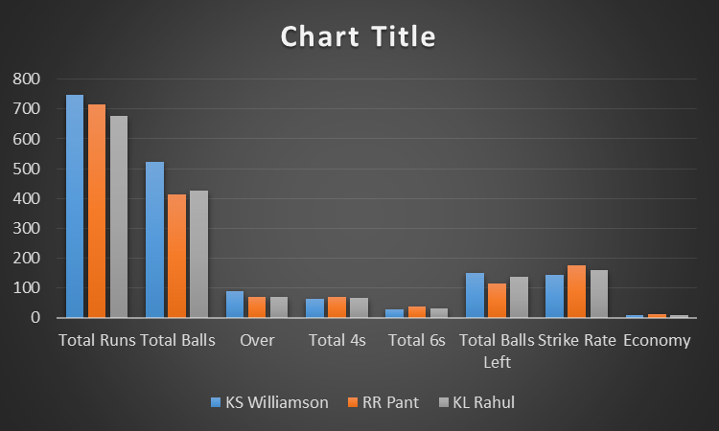
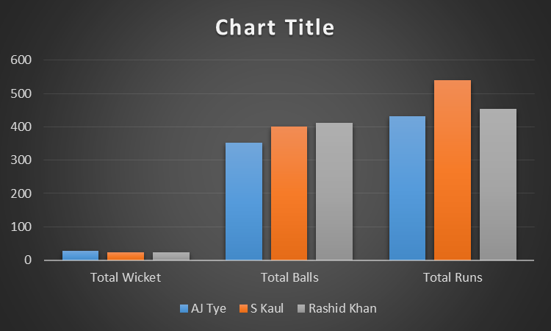
Performance trends Based on their performance, below is a chart showing the top 3 ‘Batsman and Bowler’.
BATSMAN
BOWLER

Slide 22
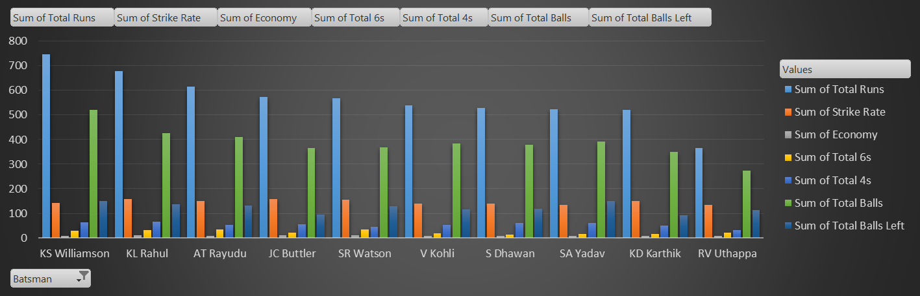
Top 10 batsmen over last 3 years
In the ‘Clustered column’, the top 10 batsman performances were displayed.

Slide 23
Derived Insights
Preliminary Insights (PI)
Core Insights (CI)

Slide 24
Preliminary Insights
The preliminary findings of each player's study and analysis based on their performance, using a multi tools for analyze and visualization such as MYSQL and MS Excel.
MYSQL: Using the query function in MYSQL, we can analyze the player's performance. Using the appropriate command, we may extract the information and generate fresh data.
MS EXCEL: We can view the data in table and chart format using MS Excel. We can also compare the resulting data, and we can visualize it with a chart for quick understanding. It allows us to divide data into rows and columns.

Slide 25
Core Insights
The project's Core Insights looked into the performance of individual players. We compared each player's performance in this study and derived fresh statistics based on the many categories.
For example, we compared each batsman's total runs, strike rate, and other statistics. We compared total balls for bowler total wickets, and so forth. These are the findings of our research for this project.
We use 'MySQL' and 'MS Excel' to get these data. To generate the required data in MySQL, we execute the appropriate command and derive data. MS Excel is used to organize data into appropriate tables and to visualize the resultant data in various charts for easier comprehension.

Slide 26
Leading Batsmen and Bowlers
The table displays the results of the analysis, which may be used to compare each player's performance.
Result table.
Batsman | Total Runs | Strike Rate | Economy
KS Williamson | 747 | 143.1034483 | 8.586206897
RR Pant | 717 | 174.0291262 | 10.39130435
KL Rahul | 678 | 159.1549296 | 9.685714286
Bowler | Total Balls | Total Wickets | Total Runs
AJ Tye | 353 | 28 | 431
S Kaul | 402 | 24 | 541
Rashid Khan | 411 | 23 | 455

Slide 27
Key Observation
We looked at how players in different categories compared in this Insight. We utilized MySQL to filter the data of each player and generate distinct data for each player for this analysis.
We used MS Excel for visualization, which is quite beneficial in tables and charts With the help of these, we can readily evaluate and compare data.
We may learn about each player's performance in different matches and years as a result of the study.
We may also analyze each player's performance and see where he is falling short and where they are strong.
The data is generated in MYSQL and saved to MS Excel in table format (Pivot Table), which is then converted to a chart for simple viewing and comprehension.

Slide 28
Discussion
The point of the project is to analyze, compare, and visualize each player using the data provided.
For analysis and visualization, we used tools like ‘MYSQL’ and ‘MS Excel‘.
We derived data such as strike rate, economy, and so on from the given data.
Through this data, we were able to determine each player's specific performance as a ‘Batsman, Bowler‘.
We may see the leading batsman and bowler in a bar chart, which is easy to understand without explanation.
We can compare each year and view them according to our preferences using the analysis.

Slide 29
Code Links
Open code using 'Github‘, click – URL
Data Link:
Spreadsheet 1 ‘IPL_Balls’ click: URL
Spreadsheet 2 ‘IPL_Matches’ click: URL

Slide 30
Conclusion
What we did in this project?
We used two tools to complete this project: 'MySQL' and 'MS Excel.' Both of these tools were quite helpful throughout the project.
The 'Sport Analyze' project involved analyzing each individual player based on their previous performance.
The batsman's analysis included total runs, strike rate, economy, and so on, while the bowler's analysis included total balls, total wickets, and so on.
The stat attack is similar to the team's name, such as Batsman.
These data are derived using MySQL, and we've visualized several of them using MS Excel's 'table & chart' feature.

